Slide 1


Principles of Information Security,
Fifth Edition
Chapter 12
Information Security Maintenance

Slide 2
Learning Objectives
Upon completion of this material, you should be able to:
  Discuss the need for ongoing maintenance of the information security program
  List the recommended security management models
  Define a model for a full maintenance program
  Identify the key factors involved in monitoring the external and internal environment
Principles of Information Security, Fifth Edition
Notes:
Learning Objectives
Upon completion of this material you should be able to:
Discuss the need for the ongoing maintenance of the information security program
List the recommended security management models
Define a model for a full maintenance program
Identify the key factors involved in monitoring the external and internal environment
Describe how planning, risk assessment, vulnerability assessment, and remediation tie into information security maintenance
Explain how to build readiness and review procedures into information security maintenance
Define digital forensics, and describe the management of the digital forensics function
Describe the process of acquiring, analyzing, and maintaining potential evidentiary material

Slide 3
Learning Objectives (cont’d)
  Describe how planning, risk assessment, vulnerability assessment, and remediation tie into information security maintenance
  Explain how to build readiness and review procedures into information security maintenance
  Discuss digital forensics, and describe how to manage it
  Describe the process of acquiring, analyzing, and maintaining potential evidentiary material
Principles of Information Security, Fifth Edition
Notes:
Learning Objectives
Describe how planning, risk assessment, vulnerability assessment, and remediation tie into information security maintenance
Explain how to build readiness and review procedures into information security maintenance
Discuss digital forensics, and describe how to manage it
Describe the process of acquiring, analyzing, and maintaining potential evidentiary material

Slide 4
Introduction
Organizations should avoid overconfidence after improving their information security profile.
Organizational changes that may occur include:
  Acquisition of new assets, emergence of new vulnerabilities, shifting business priorities, partnerships form or dissolve, employee hire and turnover
If a program is not adequately adjusting, it may be necessary to begin the cycle again.
If an organization creates adjustable procedures and systems, the existing security improvement program can continue to work well.
Principles of Information Security, Fifth Edition
Notes:
Introduction
Organizations should avoid overconfidence after improving their information security profile
Organizational changes that may occur include:
Acquisition of new assets; emergence of new vulnerabilities; shifting business priorities; partnerships form or dissolve; employee hire and turnover
If program is not adequately adjusting, may be necessary to begin cycle again
If organization creates adjustable procedures and systems, existing security improvement program can continue to work well

Slide 5
Security Management Maintenance Models
Management model must be adopted to manage and operate ongoing security program.
Models are frameworks that structure the tasks of managing particular set of activities or business functions.
Principles of Information Security, Fifth Edition
Notes:
Security Management Models
To assist the information security community to manage and operate the ongoing security program, a management model must be adopted.
In general, management models are frameworks that structure the tasks of managing a particular set of activities or business functions.

Slide 6
NIST SP 800-100 Information Security Handbook: A Guide for Managers
Provides managerial guidance for establishing and implementing an information security program
There are 13 areas of information security management presented.
  Provides for specific monitoring activities for each task
  Tasks should be done on an ongoing basis.
  Not all issues are negative.
Principles of Information Security, Fifth Edition
Notes:
NIST SP 800-100 Information Security Handbook
Provides managerial guidance for establishing and implementing an information security program
There are thirteen areas of information security management presented
Provides for specific monitoring activities for each task
Tasks should be done on an ongoing basis
Not all issues are negative

Slide 7
NIST SP 800-100 Information Security Handbook: A Guide for Managers (cont’d)
Information security governance
  Agencies should monitor the status of their programs to ensure:
    Ongoing information security activities providing appropriate support
    Policies and procedures are current.
    Controls are accomplishing their intended purpose.
System Development Life Cycle: the overall process of developing, implementing, and retiring information systems through a multistep process
Principles of Information Security, Fifth Edition
Notes:
Information security governance
Agencies should monitor the status of their programs to ensure:
Ongoing information security activities providing appropriate support
Policies and procedures are current
Controls are accomplishing their intended purpose
System Development Life Cycle: the overall process of developing, implementing, and retiring information systems through a multistep process

Slide 8
NIST SP 800-100 Information Security Handbook: A Guide for Managers (cont’d)
Awareness and training
  Tracking system should capture key information on program activities.
  Tracking compliance involves assessing the status of the program
  Security policies must continue to evolve.
Capital planning and investment control
  Departments required to allocate funding toward highest-priority investments
  Designed to facilitate the expenditure of agency funds
Principles of Information Security, Fifth Edition
Notes:
Awareness and training
Tracking system should capture key information on program activities
Tracking compliance involves assessing the status of the program
Security policies must continue to evolve
Capital planning and investment control
Departments required to allocate funding toward highest-priority investments
Designed to facilitate the expenditure of agency funds

Slide 9
NIST SP 800-100 Information Security Handbook: A Guide for Managers (cont’d)
Interconnecting systems
  The direct connection of two or more information systems for sharing data and other information resources
  Can expose the participating organizations to risk
  If one of the connected systems is compromised, interconnection could be used as conduit.
Performance measures
  Metrics should be used for monitoring the performance of information security controls.
  Six-phase iterative process
Principles of Information Security, Fifth Edition
Notes:
Interconnecting systems
The direct connection of two or more information systems for sharing data and other information resources
Can expose the participating organizations to risk
If one of connected systems compromised, interconnection could be used as conduit
Performance measures
Metrics should be used for monitoring performance of information security controls
Six phase iterative process

Slide 10
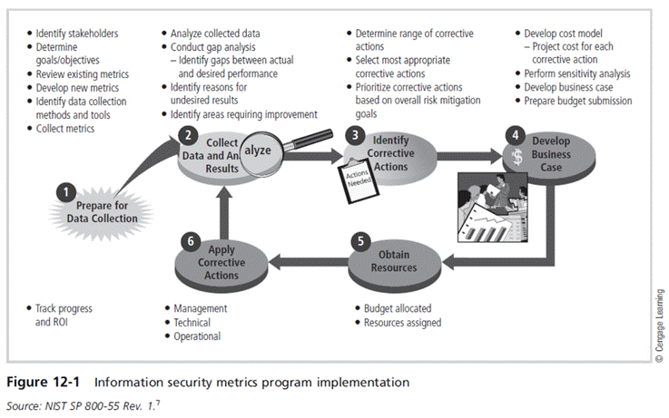
Principles of Information Security, Fifth Edition

Slide 11
NIST SP 800-100 Information Security Handbook: A Guide for Managers (cont’d)
Security planning
  One of the most crucial ongoing responsibilities in security management
Information technology contingency planning
  Consists of a process for recovery and documentation of procedures
Risk management
  Ongoing effort
  Tasks include performing risk identification, analysis, and management
Principles of Information Security, Fifth Edition
Notes:
Security planning
One of the most crucial ongoing responsibilities in security management
Information technology contingency planning
Consists of a process for recovery and documentation of procedures
Risk management
Ongoing effort
Tasks include performing risk identification, analysis, and management

Slide 12
NIST SP 800-100 Information Security Handbook: A Guide for Managers (cont’d)
Certification, accreditation, and security assessments
  An essential component of any security program
  The status of security controls is checked regularly.
  Auditing: the review of a system’s use to determine if misuse/malfeasance has occurred
Security services and products acquisition
Incident response: incident response life cycle
Configuration (or change) management: manages the effects of changes in configurations, five-step process
Principles of Information Security, Fifth Edition
Notes:
Certification, accreditation, and security assessments
An essential component of any security program
The status of security controls is checked regularly
Auditing: the review of a system’s use to determine if misuse/malfeasance has occurred
Security services and products acquisition
Incident response: incident response life cycle
Configuration (or change) management: manages the effects of changes in configurations, 5 step process

Slide 13
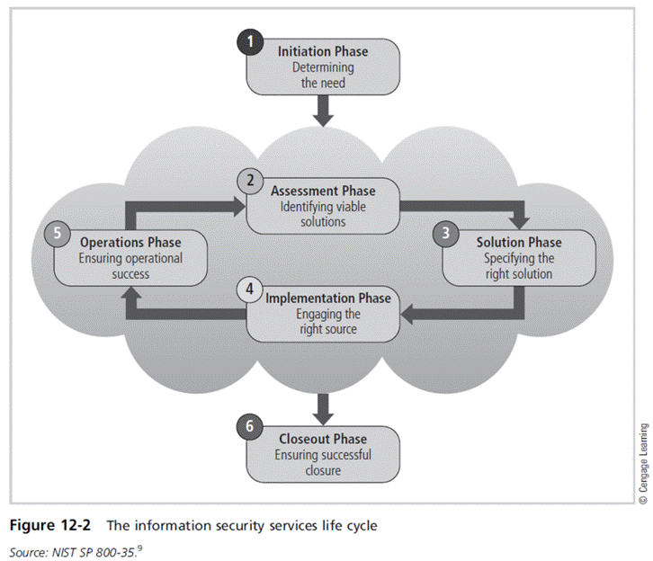
Principles of Information Security, Fifth Edition

Slide 14
The Security Maintenance Model
Designed to focus organizational effort on maintaining systems
Recommended maintenance model based on five
subject areas:
  External monitoring
  Internal monitoring
  Planning and risk assessment
  Vulnerability assessment and remediation
  Readiness and review
Principles of Information Security, Fifth Edition
Notes:
The Security Maintenance Model
Designed to focus organizational effort on maintaining systems
Recommended maintenance model based on five
subject areas:
External monitoring
Internal monitoring
Planning and risk assessment
Vulnerability assessment and remediation
Readiness and review

Slide 15
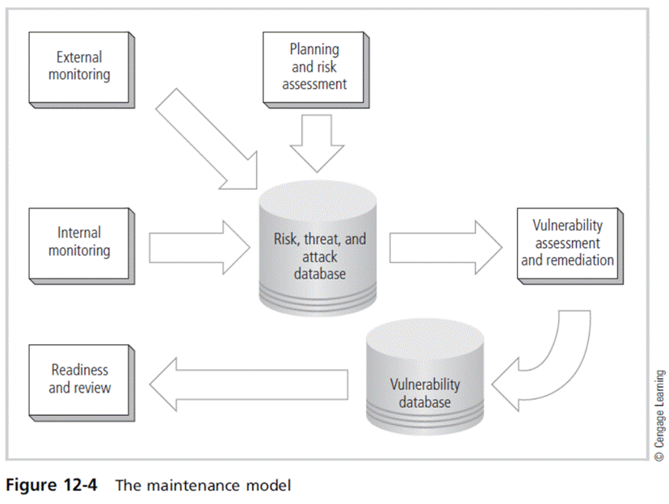
Principles of Information Security, Fifth Edition

Slide 16
Monitoring the External Environment
Objective to provide early awareness of new and emerging threats, threat agents, vulnerabilities, and attacks so organization can mount an effective defense
Entails collecting intelligence from data sources and giving that intelligence context and meaning for use by organizational decision makers
Principles of Information Security, Fifth Edition
Notes:
Monitoring the External Environment
Objective to provide early awareness of new and emerging threats, threat agents, vulnerabilities, and attacks so organization can mount an effective defense
Entails collecting intelligence from data sources and giving that intelligence context and meaning for use by organizational decision makers

Slide 17
Monitoring the External Environment (cont’d)
Data sources
  Acquiring threat and vulnerability data is not difficult.
  Turning data into information decision makers can use is the challenge.
  External intelligence comes from vendors, computer emergency response teams (CERTs), public network sources, or membership sites.
  Regardless of where or how external monitoring data are collected must be analyzed in the context of the organization’s security environment to be useful
Principles of Information Security, Fifth Edition
Notes:
Data Sources
Acquiring threat and vulnerability data is not difficult
Turning data into information decision makers can use is the challenge
External intelligence comes from: vendors, computer emergency response teams (CERTs), public network sources, or membership sites
Regardless of where or how external monitoring data is collected, must be analyzed in context of organization’s security environment to be useful

Slide 18
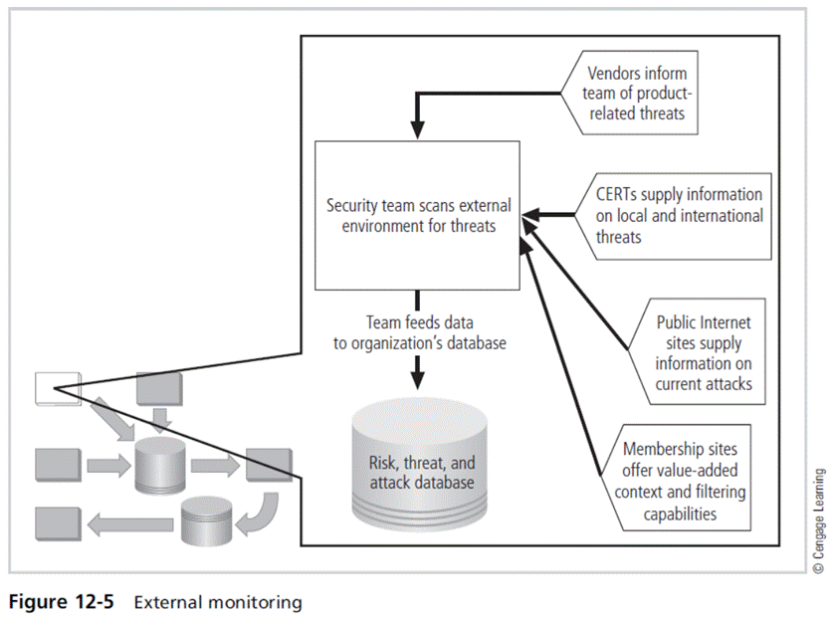
Principles of Information Security, Fifth Edition

Slide 19
Monitoring the External Environment (cont’d)
Monitoring, escalation, and incident response
  Function of external monitoring process is to monitor activity, report results, and escalate warnings
  Monitoring process has three primary deliverables:
    Specific warning bulletins issued when developing threats and specific attacks pose measurable risk to the organization.
    Periodic summaries of external information
    Detailed intelligence on highest risk warnings
Principles of Information Security, Fifth Edition
Notes:
Monitoring, Escalation, and Incident Response
Function of external monitoring process is to monitor activity, report results, and escalate warnings
Monitoring process has three primary deliverables:
Specific warning bulletins issued when developing threats and specific attacks pose measurable risk to organization
Periodic summaries of external information
Detailed intelligence on highest risk warnings

Slide 20
Monitoring the External Environment (cont’d)
Data collection and management
  Over time, external monitoring processes should capture information about external environment in appropriate formats.
  External monitoring collects raw intelligence, filters for relevance, assigns a relative risk impact, and communicates to decision makers in time to make a difference.
Principles of Information Security, Fifth Edition
Notes:
Data Collection and Management
Over time, external monitoring processes should capture information about external environment in appropriate formats
External monitoring collects raw intelligence, filters for relevance, assigns a relative risk impact, and communicates to decision makers in time to make a difference

Slide 21
Monitoring the Internal Environment
Primary goal is informed awareness of state of organization’s networks, systems, and security defenses.
Internal monitoring accomplished by:
  Inventorying network devices and channels, IT infrastructure and applications, and information security infrastructure elements
  Leading the IT governance process
  Real-time monitoring of IT activity
  Monitoring the internal state of the organization’s networks and systems
Principles of Information Security, Fifth Edition
Notes:
Monitoring the Internal Environment
Primary goal is informed awareness of state of organization’s networks, systems, and security defenses
Internal monitoring accomplished by:
Inventorying network devices and channels, IT infrastructure and applications, and information security infrastructure elements
Leading the IT governance process
Real-time monitoring of IT activity
Monitoring the internal state of the organization’s networks and systems

Slide 22
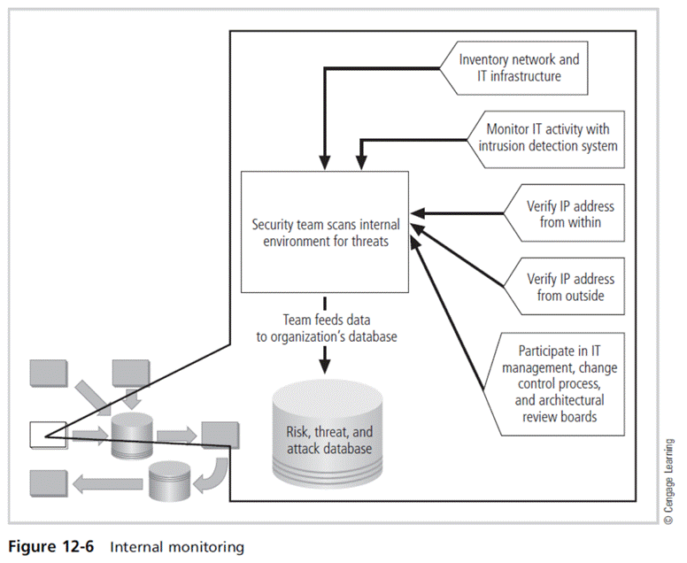
Principles of Information Security, Fifth Edition

Slide 23
Monitoring the Internal Environment (cont’d)
Network characterization and inventory
  Organizations should have/maintain carefully planned and fully populated inventory of network devices, communication channels, and computing devices.
  Once characteristics are identified, they must be carefully organized and stored using a mechanism (manual or automated) that allows timely retrieval and rapid integration of disparate facts.
Principles of Information Security, Fifth Edition
Notes:
Network Characterization and Inventory
Organizations should have/maintain carefully planned and fully populated inventory of network devices, communication channels, and computing devices
Once characteristics identified, they must be carefully organized and stored using a mechanism (manual or automated) that allows timely retrieval and rapid integration of disparate facts

Slide 24
Monitoring the Internal Environment (cont’d)
Making intrusion detection and prevention systems work
  The most important value of raw intelligence provided by the IDS is providing indicators of current or imminent vulnerabilities.
  Log files from IDS engines can be mined for information.
  Another IDS monitoring element is traffic analysis.
  Analyzing attack signatures from unsuccessful system attacks can identify weaknesses in various security efforts.
Principles of Information Security, Fifth Edition
Notes:
Making Intrusion Detection and Prevention Systems Work
The most important value of raw intelligence provided by the IDS is providing indicators of current or imminent vulnerabilities
Log files from IDS engines can be mined for information
Another IDS monitoring element is traffic analysis
Analyzing attack signatures from unsuccessful system attacks can identify weaknesses in various security efforts

Slide 25
Monitoring the Internal Environment (cont’d)
Detecting differences
  Difference analysis: procedure that compares current state of network segment against known previous state of same segment
  Unexpected differences between the current state and the baseline state could indicate trouble.
Principles of Information Security, Fifth Edition
Notes:
Detecting Differences
Difference analysis: procedure that compares current state of network segment against known previous state of same segment
Unexpected differences between the current state and the baseline state could indicate trouble

Slide 26
Planning and Risk Assessment
Primary objective is to keep a lookout over the entire information security program.
Accomplished by identifying and planning ongoing information security activities that further reduce risk
Principles of Information Security, Fifth Edition
Notes:
Planning and Risk Assessment
Primary objective is to keep lookout over entire information security program
Accomplished by identifying and planning ongoing information security activities that further reduce risk

Slide 27
Planning and Risk Assessment (cont’d)
Primary objectives
  Establishing a formal information security program review process
  Instituting formal project identification, selection, planning, and management processes
  Coordinating with IT project teams to introduce risk assessment and review for all IT projects
  Integrating a mindset of risk assessment throughout organization
Principles of Information Security, Fifth Edition
Notes:
Planning and Risk Assessment
Primary objectives
Establishing a formal information security program review process
Instituting formal project identification, selection, planning, and management processes
Coordinating with IT project teams to introduce risk assessment and review for all IT projects
Integrating a mindset of risk assessment throughout organization

Slide 28
Planning and Risk Assessment (cont’d)
Information security program planning
and review
  Periodic review of ongoing information security program and planning for enhancements and extensions is recommended.
  Should examine future IT needs of organization and its impact on information security
  A recommended approach takes advantage of the fact that most organizations have annual capital budget planning cycles and manage security projects as part of that process.
Principles of Information Security, Fifth Edition
Notes:
Information Security Program Planning and Review
Periodic review of ongoing information security program and planning for enhancements and extensions is recommended
Should examine future IT needs of organization and impact on information security
A recommended approach takes advantage of the fact most organizations have annual capital budget planning cycles and manage security projects as part of that process

Slide 29
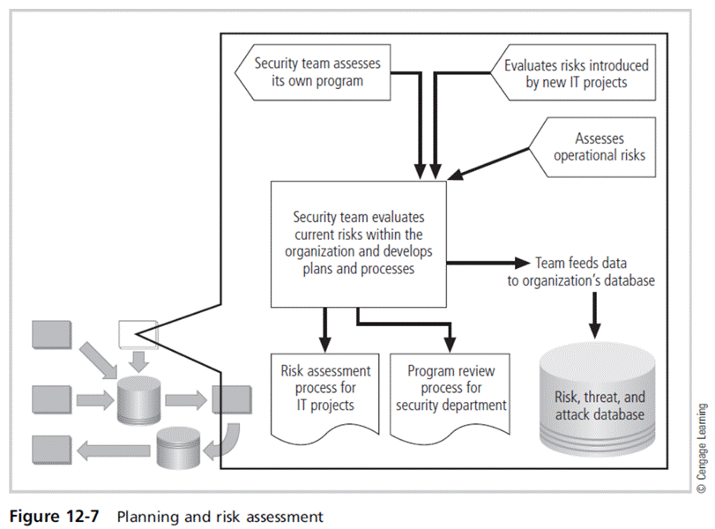
Principles of Information Security, Fifth Edition

Slide 30
Planning and Risk Assessment (cont’d)
Large projects should be broken into smaller projects for several reasons:
  Smaller projects tend to have more manageable impacts on networks and users.
  Larger projects tend to complicate the change control process in the implementation phase.
  Shorter planning, development, and implementation schedules reduce uncertainty.
  Most large projects can easily be broken down into smaller projects, giving more opportunities to change direction and gain flexibility.
Principles of Information Security, Fifth Edition
Notes:
Planning and Risk Assessment
Large projects should be broken into smaller projects for several reasons
Smaller projects tend to have more manageable impacts on networks and users
Larger projects tend to complicate change control process in implementation phase
Shorter planning, development, and implementation schedules reduce uncertainty
Most large projects can easily be broken down into smaller projects, giving more opportunities to change direction and gain flexibility

Slide 31
Planning and Risk Assessment (cont’d)
Security risk assessments
  A key component for driving security program change is risk assessment (RA).
  RA identifies and documents the risk that a project, process, or action introduces to the organization and offers suggestions for controls.
  Information security group coordinates the preparation of many types of RA documents.
Principles of Information Security, Fifth Edition
Notes:
Security Risk Assessments
A key component for driving security program change is risk assessment (RA)
RA identifies and documents risk that a project, process, or action introduces to organization and offers suggestions for controls
Information security group coordinates preparation of many types of RA documents

Slide 32
Vulnerability Assessment and Remediation
Primary goal: identification of specific, documented vulnerabilities and their timely remediation
Accomplished by:
  Using vulnerability assessment procedures
  Documenting background information and providing tested remediation procedures for vulnerabilities
  Tracking vulnerabilities from the time they are identified
  Communicating vulnerability information to owners of vulnerable systems
  Reporting on the status of vulnerabilities
  Ensuring the proper level of management is involved
Principles of Information Security, Fifth Edition
Notes:
Vulnerability Assessment and Remediation
Primary goal: identification of specific, documented vulnerabilities and their timely remediation
Accomplished by:
Using vulnerability assessment procedures
Documenting background information and providing tested remediation procedures for vulnerabilities
Tracking vulnerabilities from the time they are identified
Communicating vulnerability information to owners of vulnerable systems
Reporting on the status of vulnerabilities
Ensuring the proper level of management is involved

Slide 33
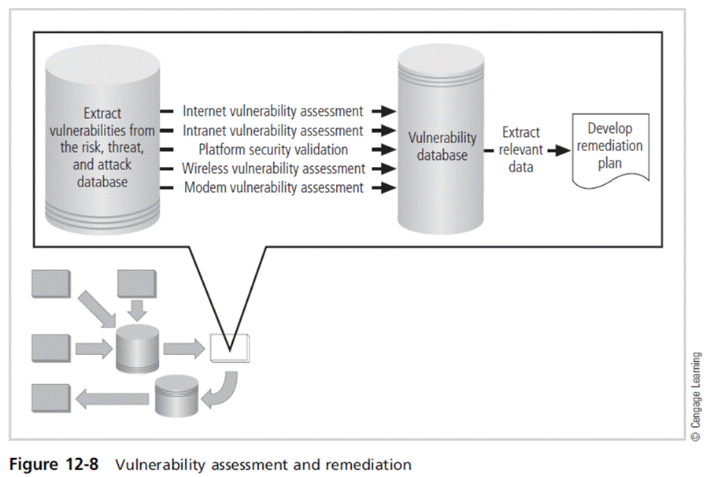
Principles of Information Security, Fifth Edition

Slide 34
Vulnerability Assessment and Remediation (cont’d)
Process of identifying and documenting specific and provable flaws in the organization’s information asset environment
Five following vulnerability assessment processes can help many organizations balance intrusiveness of vulnerability assessment with the need for stable and effective production environment.
Principles of Information Security, Fifth Edition
Notes:
Vulnerability Assessment and Remediation
Process of identifying and documenting specific and provable flaws in organization’s information asset environment
Five following vulnerability assessment processes can help many organizations balance intrusiveness of vulnerability assessment with need for stable and effective production environment

Slide 35
Vulnerability Assessment and Remediation (cont’d)
Penetration testing
  A level beyond vulnerability testing
  Is a set of security tests and evaluations that simulate attacks by a malicious external source (hacker)
  Penetration test (pen test): usually performed periodically as part of a full security audit
  Can be conducted one of two ways: black box or white box
Principles of Information Security, Fifth Edition
Notes:
Penetration testing
A level beyond vulnerability testing
Is a set of security tests and evaluations that simulate attacks by a malicious external source (hacker)
Penetration test (pen test): usually performed periodically as part of a full security audit
Can be conducted one of two ways: black box or white box

Slide 36
Vulnerability Assessment and Remediation (cont’d)
Internet vulnerability assessment
  Designed to find and document vulnerabilities present in an organization’s public network
  Steps in the process include:
    Planning, scheduling, and notification
    Target selection
    Test selection
    Scanning
    Analysis
    Record keeping
Principles of Information Security, Fifth Edition
Notes:
Internet Vulnerability Assessment
Designed to find and document vulnerabilities present in organization’s public network
Steps in the process include:
Planning, scheduling, and notification
Target selection
Test selection
Scanning
Analysis
Record keeping

Slide 37
Vulnerability Assessment and Remediation (cont’d)
Intranet vulnerability assessment
  Designed to find and document the selected vulnerabilities likely present on the internal network
  Attackers are often internal members of the organization, affiliates of business partners, or automated attack vectors (such as viruses and worms).
  This assessment is usually performed against critical internal devices with a known, high value by using selective penetration testing.
  Steps in the process are almost identical to the steps in the Internet vulnerability assessment.
Principles of Information Security, Fifth Edition
Notes:
Intranet Vulnerability Assessment
Designed to find and document selected vulnerabilities likely present on the internal network
Attackers are often internal members of organization, affiliates of business partners, or automated attack vectors (such as viruses and worms)
This assessment is usually performed against critical internal devices with a known, high value by using selective penetration testing
Steps in process almost identical to steps in Internet vulnerability assessment

Slide 38
Vulnerability Assessment and Remediation (cont’d)
Platform security validation
  Designed to find and document vulnerabilities that may be present because misconfigured systems are in use within the organization
  These misconfigured systems fail to comply with company policy or standards.
  Fortunately, automated measurement systems are available to help with the intensive process of validating the compliance of platform configuration with policy.
Principles of Information Security, Fifth Edition
Notes:
Platform Security Validation
Designed to find and document vulnerabilities that may be present because misconfigured systems are in use within organization
These misconfigured systems fail to comply with company policy or standards
Fortunately, automated measurement systems are available to help with the intensive process of validating compliance of platform configuration with policy

Slide 39
Vulnerability Assessment and Remediation (cont’d)
Wireless vulnerability assessment
  Designed to find and document vulnerabilities that may be present in wireless local area networks of the organization
  Since attackers from this direction are likely to take advantage of any flaw, assessment is usually performed against all publicly accessible areas using every possible wireless penetration testing approach.
Principles of Information Security, Fifth Edition
Notes:
Wireless Vulnerability Assessment
Designed to find and document vulnerabilities that may be present in wireless local area networks of organization
Since attackers from this direction are likely to take advantage of any flaw, assessment is usually performed against all publicly accessible areas using every possible wireless penetration testing approach

Slide 40
Vulnerability Assessment and Remediation (cont’d)
Modem vulnerability assessment
  Designed to find and document any vulnerability present on dial-up modems connected to the organization’s networks
  Since attackers from this direction take advantage of any flaw, assessment is usually performed on all telephone numbers owned by the organization.
  One element of this process, often called war dialing, uses scripted dialing attacks against a pool of phone numbers.
Principles of Information Security, Fifth Edition
Notes:
Modem Vulnerability Assessment
Designed to find and document any vulnerability present on dial-up modems connected to organization’s networks
Since attackers from this direction take advantage of any flaw, assessment is usually performed on all telephone numbers owned by the organization
One element of this process, often called war dialing, uses scripted dialing attacks against pool of phone numbers

Slide 41
Vulnerability Assessment and Remediation (cont’d)
Documenting vulnerabilities
  Vulnerability database should provide details about reported vulnerability as well as a link to the information assets.
  Low-cost and ease of use makes relational databases a realistic choice.
  Vulnerability database is an essential part of effective remediation.
Principles of Information Security, Fifth Edition
Notes:
Documenting Vulnerabilities
Vulnerability database should provide details about reported vulnerability as well as a link to the information assets
Low-cost and ease of use makes relational databases a realistic choice
Vulnerability database is an essential part of effective remediation

Slide 42
Vulnerability Assessment and Remediation (cont’d)
Remediating vulnerabilities
  Objective is to repair flaw causing a vulnerability instance or remove risk associated with vulnerability.
  As last resort, informed decision makers with proper authority can accept risk.
  Important to recognize that building relationships with those who control information assets is key to success
  Success depends on the organization adopting team approach to remediation, in place of cross-organizational push and pull.
Principles of Information Security, Fifth Edition
Notes:
Remediating Vulnerabilities
Objective is to repair flaw causing a vulnerability instance or remove risk associated with vulnerability
As last resort, informed decision makers with proper authority can accept risk
Important to recognize that building relationships with those who control information assets is key to success
Success depends on organization adopting team approach to remediation, in place of cross-organizational push and pull

Slide 43
Vulnerability Assessment and Remediation (cont’d)
Acceptance or transference of risk
  In some instances, risk must be either simply acknowledged as part of the organization’s business process or transferred to another organization via insurance.
  Management must be assured that decisions made to accept risk or buy insurance were made by properly informed decision makers.
  Information security must make sure the right people make risk assumption decisions with complete knowledge of the impact of the decision.
Principles of Information Security, Fifth Edition
Notes:
Acceptance or Transference of Risk
In some instances, risk must either simply be acknowledged as part of organization’s business process or transferred to another organization via insurance
Management must be assured that decisions made to accept risk or buy insurance were made by properly informed decision makers
Information security must make sure the right people make risk assumption decisions with complete knowledge of the impact of the decision

Slide 44
Vulnerability Assessment and Remediation (cont’d)
Threat removal
  In some circumstances, threats can be removed without repairing vulnerability.
  Other vulnerabilities may be mitigated by inexpensive controls.
Vulnerability repair
  Best solution in most cases is to repair vulnerability.
  Applying patch software or implementing a workaround often accomplishes this.
  Most common repair is the application of a software patch.
Principles of Information Security, Fifth Edition
Notes:
Threat removal
In some circumstances, threats can be removed without repairing vulnerability
Other vulnerabilities may be mitigated by inexpensive controls
Vulnerability repair
Best solution in most cases is to repair vulnerability
Applying patch software or implementing a workaround often accomplishes this
Most common repair is application of a software patch

Slide 45
Readiness and Review
Primary goal is to keep information security program functioning as designed and continuously improving.
Accomplished by:
  Policy review
  Program review
  Rehearsals
Principles of Information Security, Fifth Edition
Notes:
Readiness and Review
Primary goal is to keep information security program functioning as designed and continuously improving
Accomplished by:
Policy review
Program review
Rehearsals

Slide 46
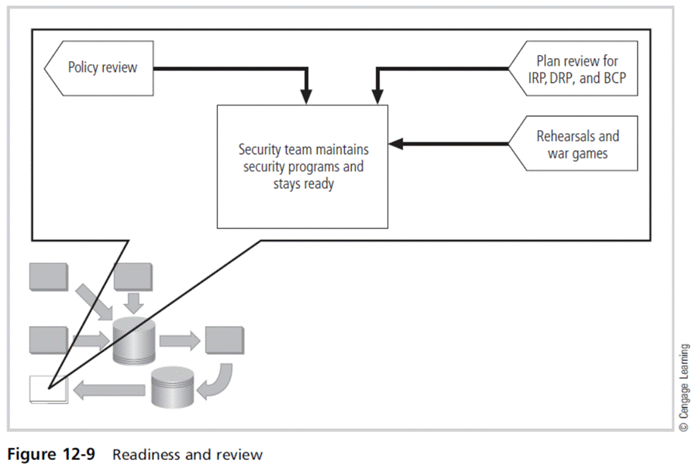
Principles of Information Security, Fifth Edition

Slide 47
Digital Forensics
Used to document what happened during attack on assets and how attack occurred
Based on the field of traditional forensics
Involves preservation, identification, extraction, documentation, and interpretation of digital media for evidentiary and/or root-cause analysis
Evidentiary material (EM): any item or information that applies to an organization’s legal or policy-based case
Principles of Information Security, Fifth Edition
Notes:
Digital Forensics
Used to document what happened during attack on assets and how attack occurred
Based on the field of traditional forensics
Involves preservation, identification, extraction, documentation, and interpretation of digital media for evidentiary and/or root cause analysis
Evidentiary material (EM): any item or information that applies to an organization’s legal or policy-based case

Slide 48
Digital Forensics (cont’d)
Used for two key purposes:
  To investigate allegations of digital malfeasance
  To perform root-cause analysis
Organization chooses one of two approaches:
  Protect and forget (patch and proceed): defense of data and systems that house, use, and transmit it
  Apprehend and prosecute (pursue and prosecute): identification and apprehension of responsible individuals, with additional attention to collection and preservation of potential EM that might support administrative or criminal prosecution
Principles of Information Security, Fifth Edition
Notes:
Digital Forensics
Used for two key purposes:
To investigate allegations of digital malfeasance
To perform root cause analysis
Organization chooses one of two approaches:
Protect and forget (patch and proceed): defense of data and systems that house, use, and transmit it
Apprehend and prosecute (pursue and prosecute): identification and apprehension of responsible individuals, with additional attention to collection and preservation of potential EM that might support administrative or criminal prosecution

Slide 49
The Digital Forensics Team
Most organizations
  Cannot sustain a permanent digital forensics team
  Collect data and outsource analysis
Information security group personnel should be trained to understand and manage the forensics process to avoid contamination of potential EM.
Expertise can be obtained by training.
Principles of Information Security, Fifth Edition
Notes:
The Digital Forensics Team
Most organizations
Cannot sustain a permanent digital forensics team
Collect data and outsource analysis
Information security group personnel should be trained to understand and manage the forensics process to avoid contamination of potential EM
Expertise can be obtained by training

Slide 50
Affidavits and Search Warrants
Affidavit
  Sworn testimony that certain facts are in the possession of the investigating officer; can be used to request a search warrant
  The facts, the items, and the place must be specified.
When an approving authority signs the affidavit, it becomes a search warrant, giving permission to:
  Search for EM at a specified location
  Seize specific items for official examination
Principles of Information Security, Fifth Edition
Notes:
Affidavits and Search Warrants
Affidavit
Sworn testimony that certain facts are in the possession of the investigating officer; can be used to request a search warrant
The facts, the items, and the place must be specified
When an approving authority signs the affidavit it becomes a search warrant, giving permission to:
Search for EM at a specified location
Seize specific items for official examination

Slide 51
Digital Forensics Methodology
All investigations follow the same basic methodology.
  Identify relevant EM
  Acquire (seize) the evidence without alteration or damage
  Take steps to assure that the evidence is at every step verifiably authentic and is unchanged from the time it was seized
  Analyze the data without risking modification or unauthorized access
  Report the findings to the proper authority
Principles of Information Security, Fifth Edition
Notes:
Digital Forensics Methodology
All investigations follow the same basic methodology
Identify relevant EM
Acquire (seize) the evidence without alteration or damage
Take steps to assure that the evidence is at every step verifiably authentic and is unchanged from the time it was seized
Analyze the data without risking modification or unauthorized access
Report the findings to the proper authority

Slide 52
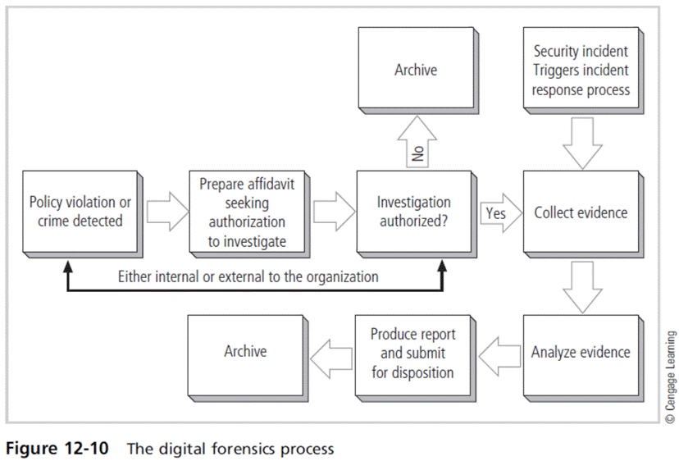
Principles of Information Security, Fifth Edition

Slide 53
Evidentiary Procedures
Strong procedures for handling potential evidentiary material can minimize the probability of an organization losing a legal challenge.
Organizations should develop specific procedures, along with guidance for effective use.
Should be supported by a procedures manual
Principles of Information Security, Fifth Edition
Notes:
Evidentiary Procedures
Strong procedures for handling potential evidentiary material can minimize the probability of an organization’s losing a legal challenge
Organizations should develop specific procedures, along with guidance for effective use
Should be supported by a procedures manual

Slide 54
Summary
Maintenance of information security program is essential.
Security management models assist in planning for ongoing operations.
It is necessary to monitor the external and internal environment.
Planning and risk assessment are the essential parts of information security maintenance.
Principles of Information Security, Fifth Edition

Slide 55
Summary (cont’d)
Need to understand how vulnerability assessment and remediation tie into information security maintenance
Need to understand how to build readiness and review procedures into information security maintenance
Digital forensics and management of digital forensics function
Principles of Information Security, Fifth Edition

